Slide 1


Evidences for collectivity in small systems
Mingliang Zhou
Stony Brook University
Advisor: Prof. Jiangyong Jia
Physics Ph.D. Defense
March 4th 2019

Slide 2
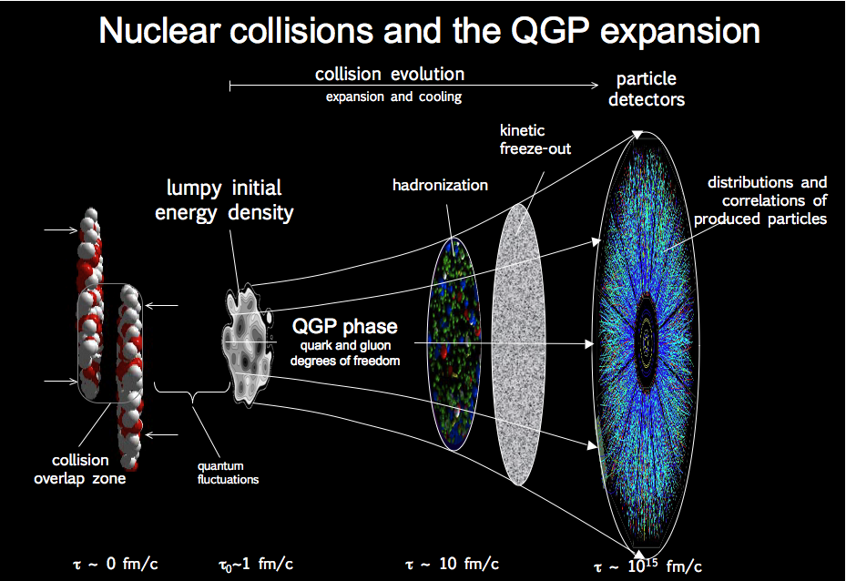
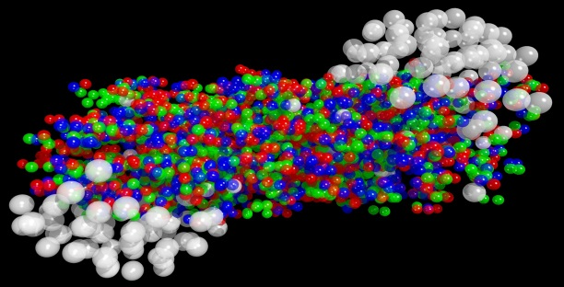
Heavy ion collision
Goal
Observe
Full picture of fireball evolution
Long-range longitudinal correlation
Long-range azimuthal correlation

Slide 3
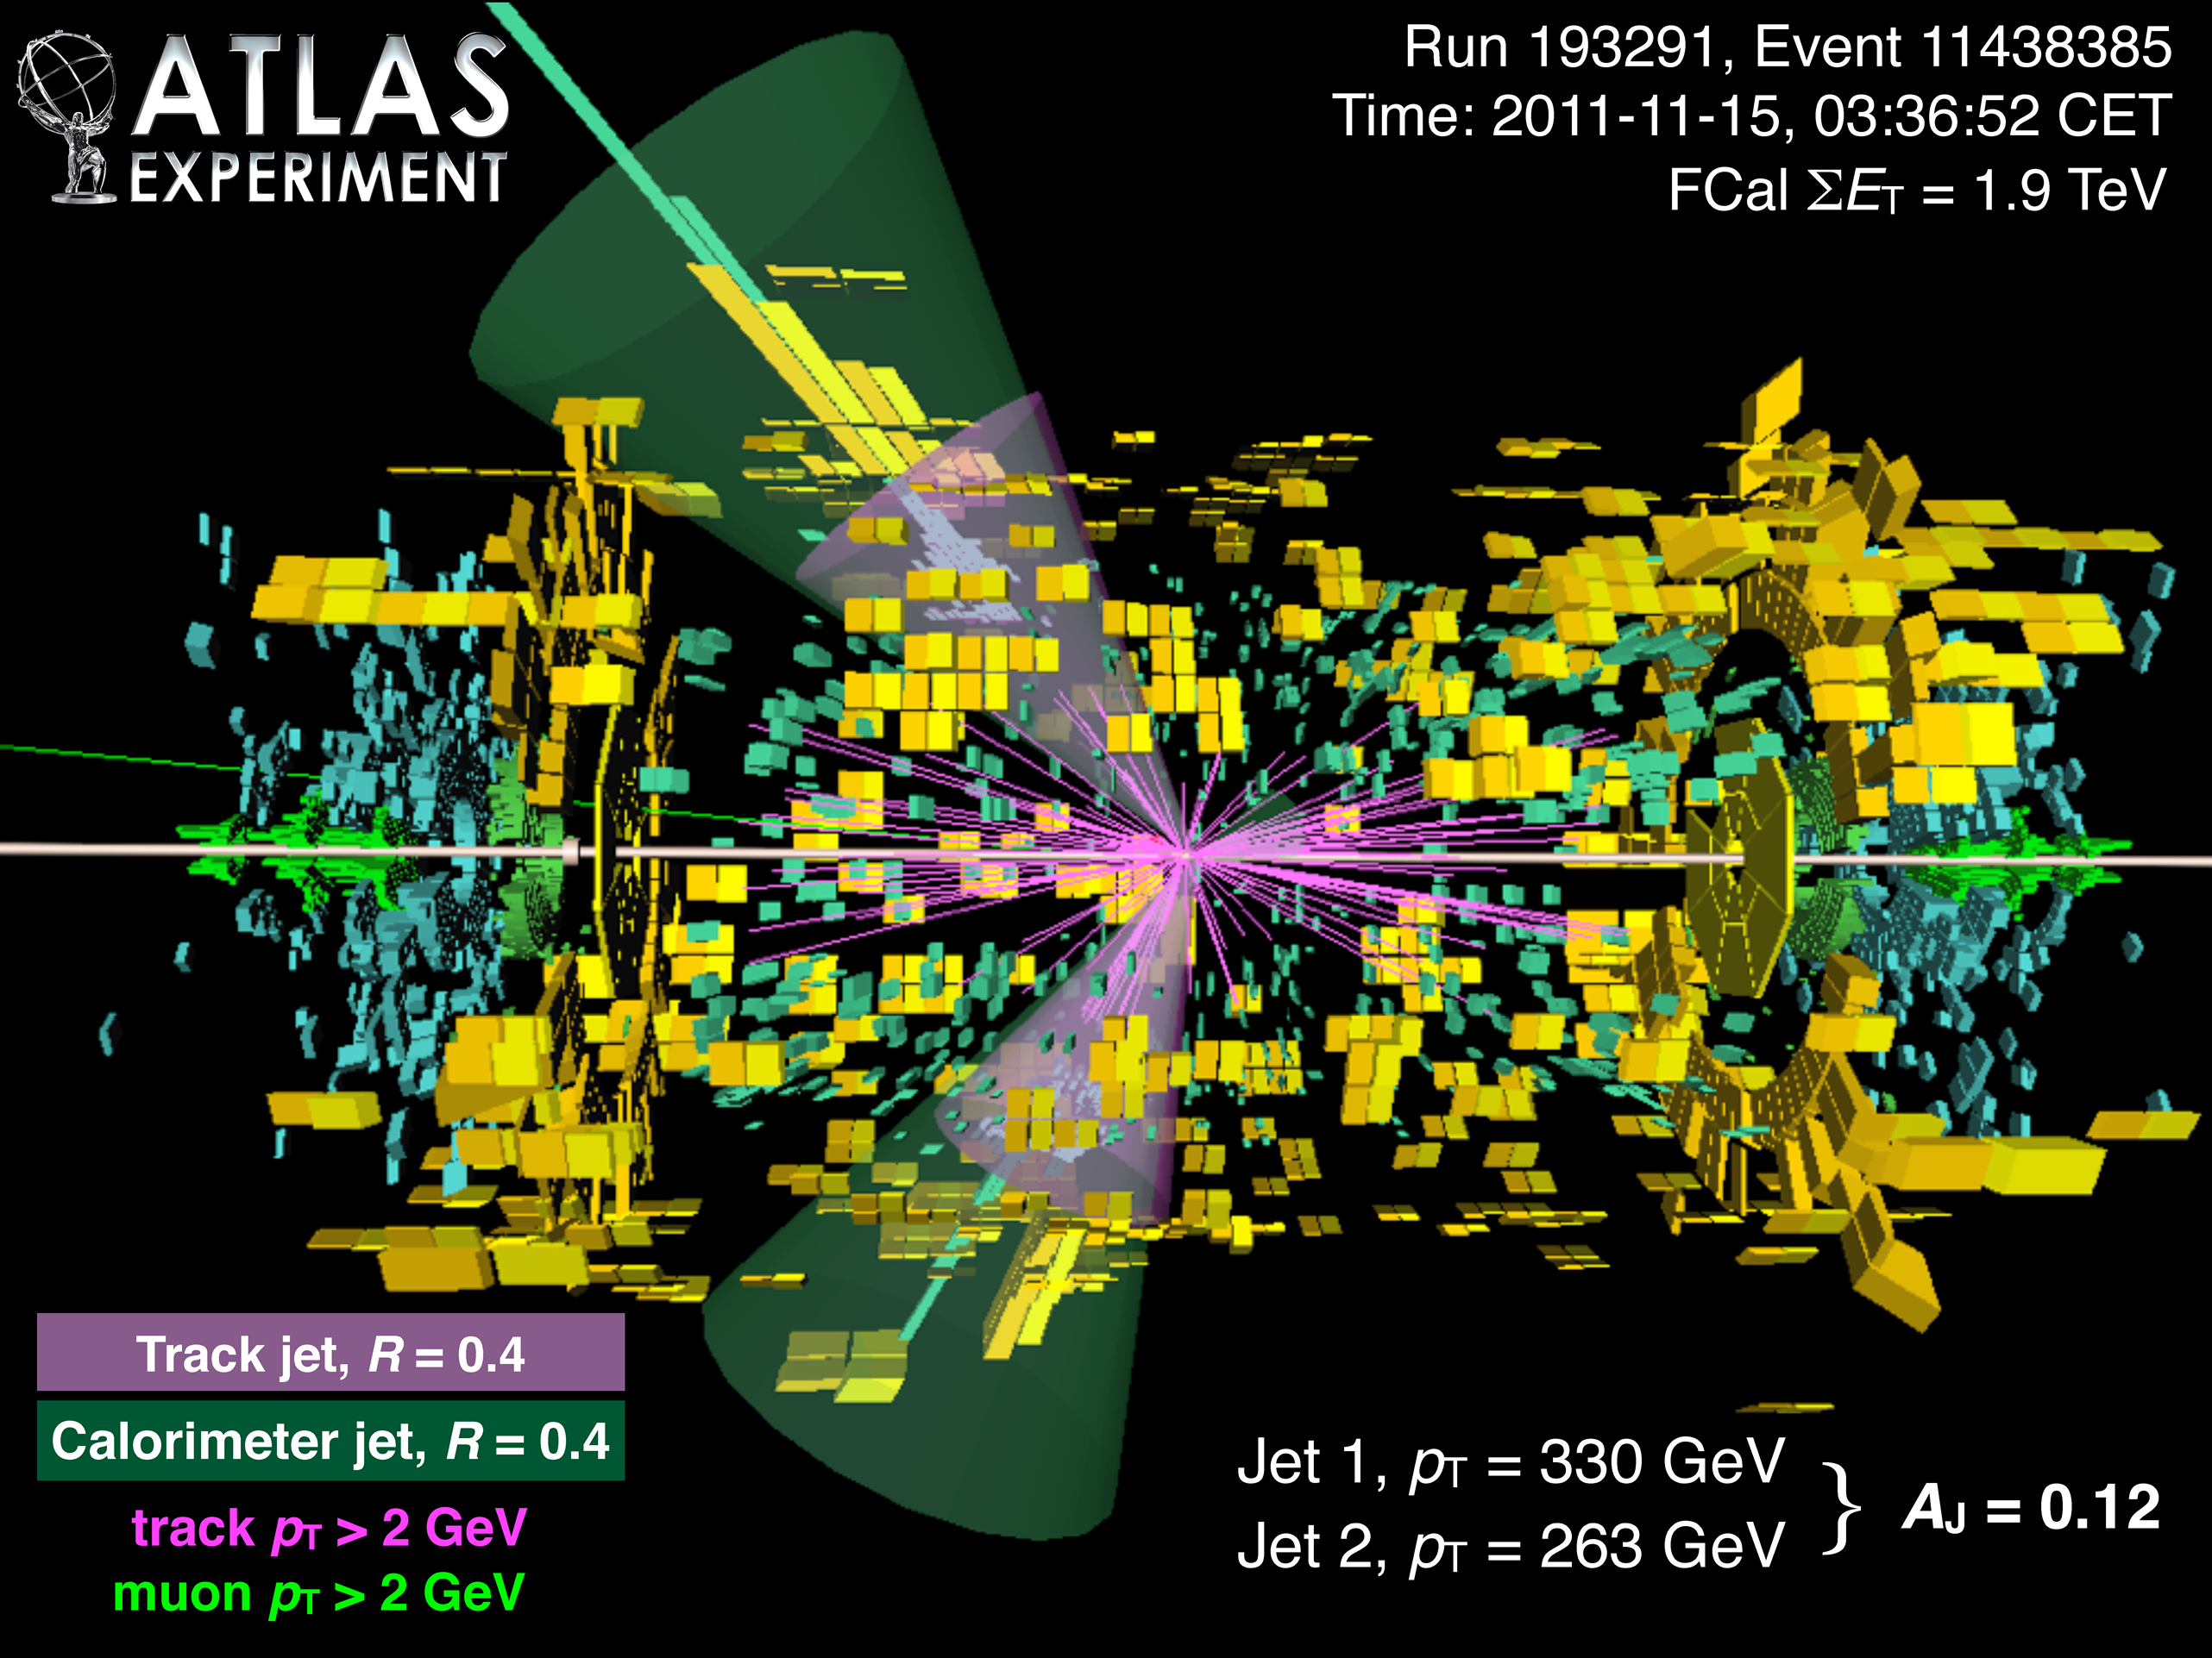
Why collectivity?
Collectivity: condition of an entity having properties its parts do not have, due to interactions among the parts.
We do not care rare events or rare particles;
We care how the system behaves as a whole.
Particles not from a common source: jet, resonance decay…
named non-flow/short-range correlation
Particles from a common source: named (long-range) collectivity
This is not about rare events or rare particles;
It is about how the system behaves as a whole;
We need to look at the bulk of particle production. All the particles you see are useful here.

Slide 4
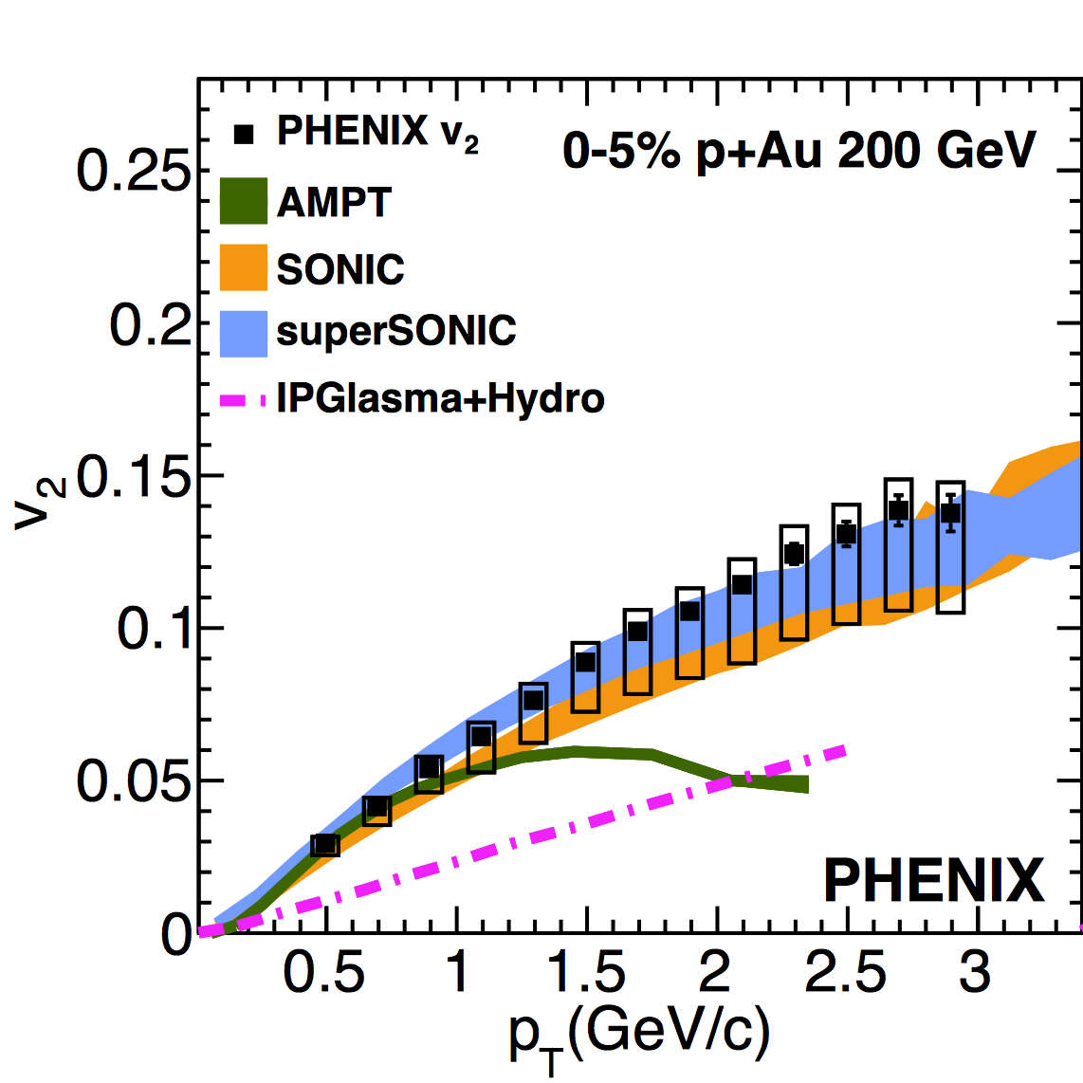
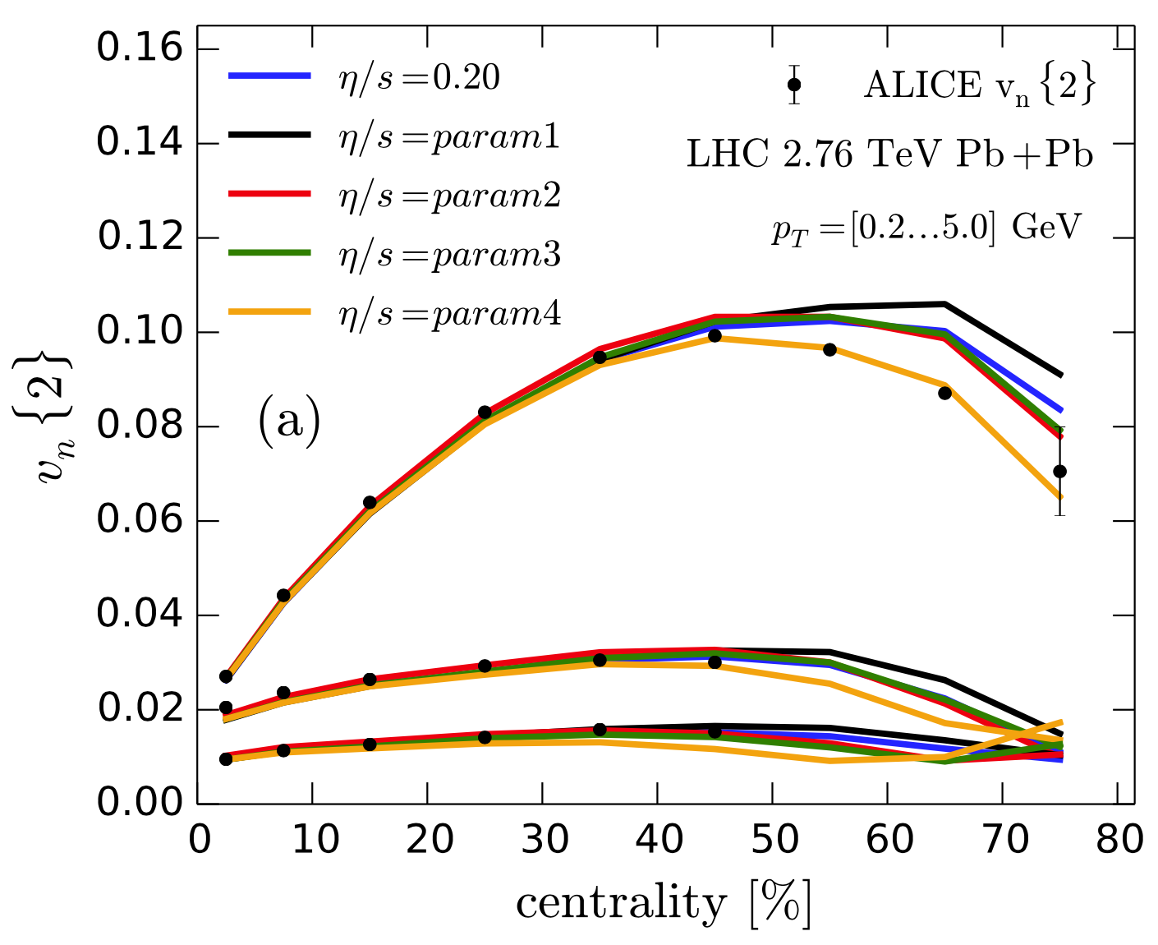
Why small systems?
Success of models in large systems;
Parameters not well constrained.
Not so good in small systems;
QGP in small systems?
Larger proton fluctuation can better distinguish different models

Slide 5

How to use data to constrain models?
Approach 1
Approach 2
param 2
param 2
Model A
Model A
param 1
param 1
Independent constrains
Observable
Collision system
Collision energy
Improve data statistical significance
High-multiplicity $pp$ and $p$+Pb events

Slide 6
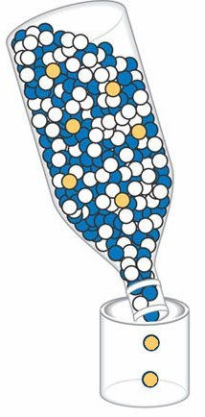
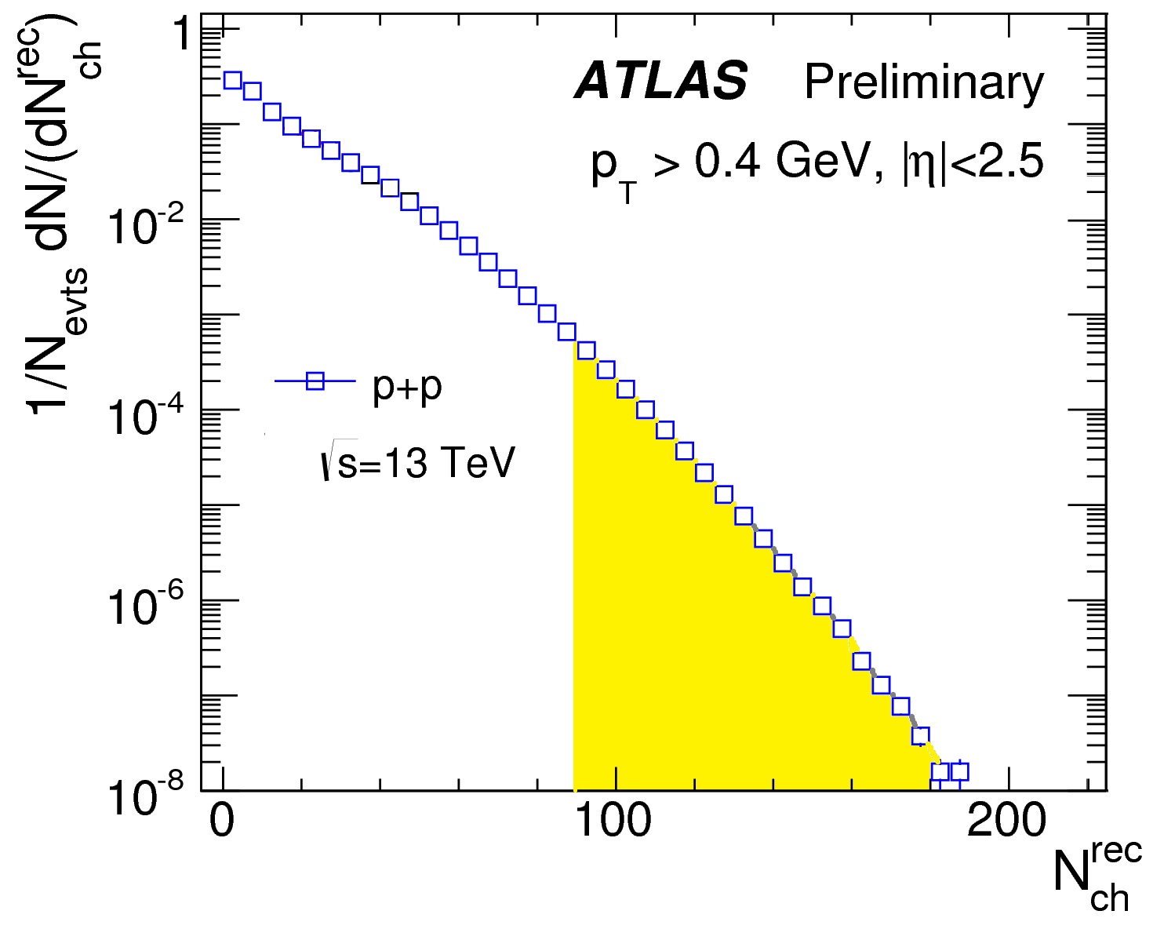
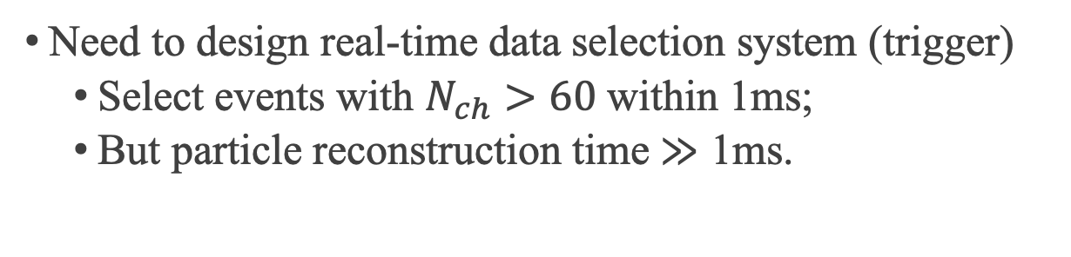
Real-time data selection
LHC event rate
40 MHz
What
we need
Recording cap
10 kHz
Need to design real-time data selection system (trigger)
Select events with $N_{ch}>60$ within 1ms;
But particle reconstruction time $≫$ 1ms.

Slide 7
Fast online track reconstruction
Var 2
HM events
All events
Var 1
Sequence and thresholds of cuts designed to maximize performance.

Slide 8
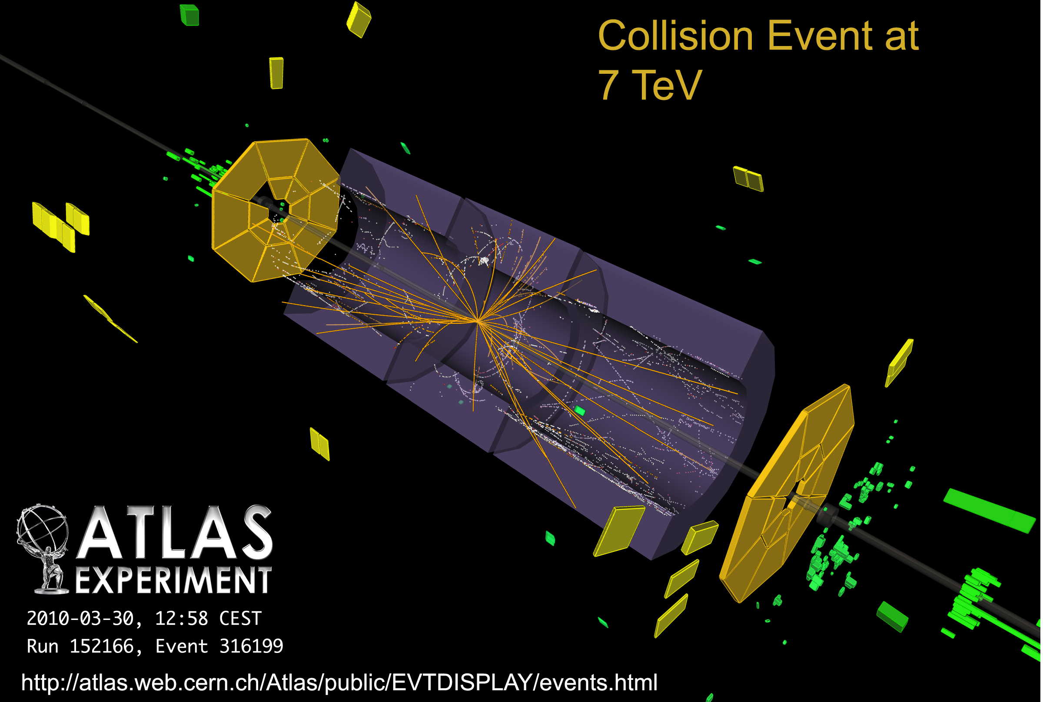
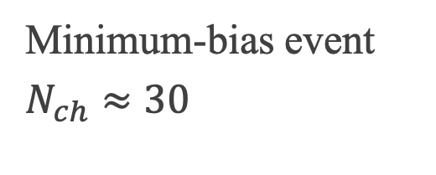
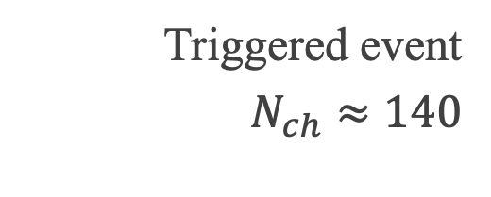
Event display
Minimum-bias event
$N_{ch}≈30$
Triggered event
$N_{ch}≈140$

Slide 9
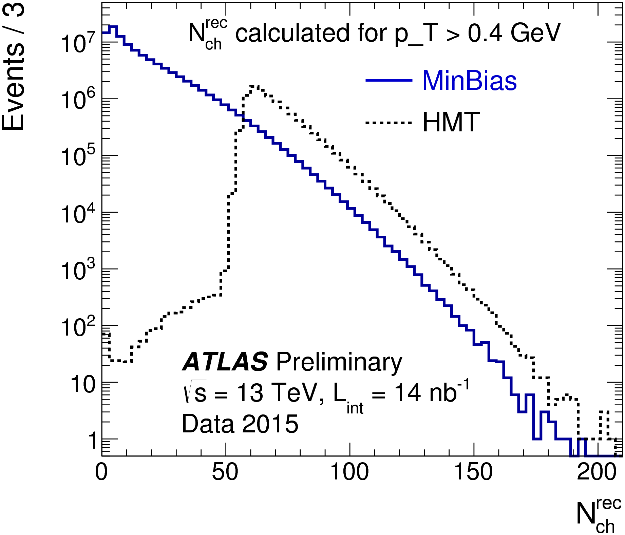
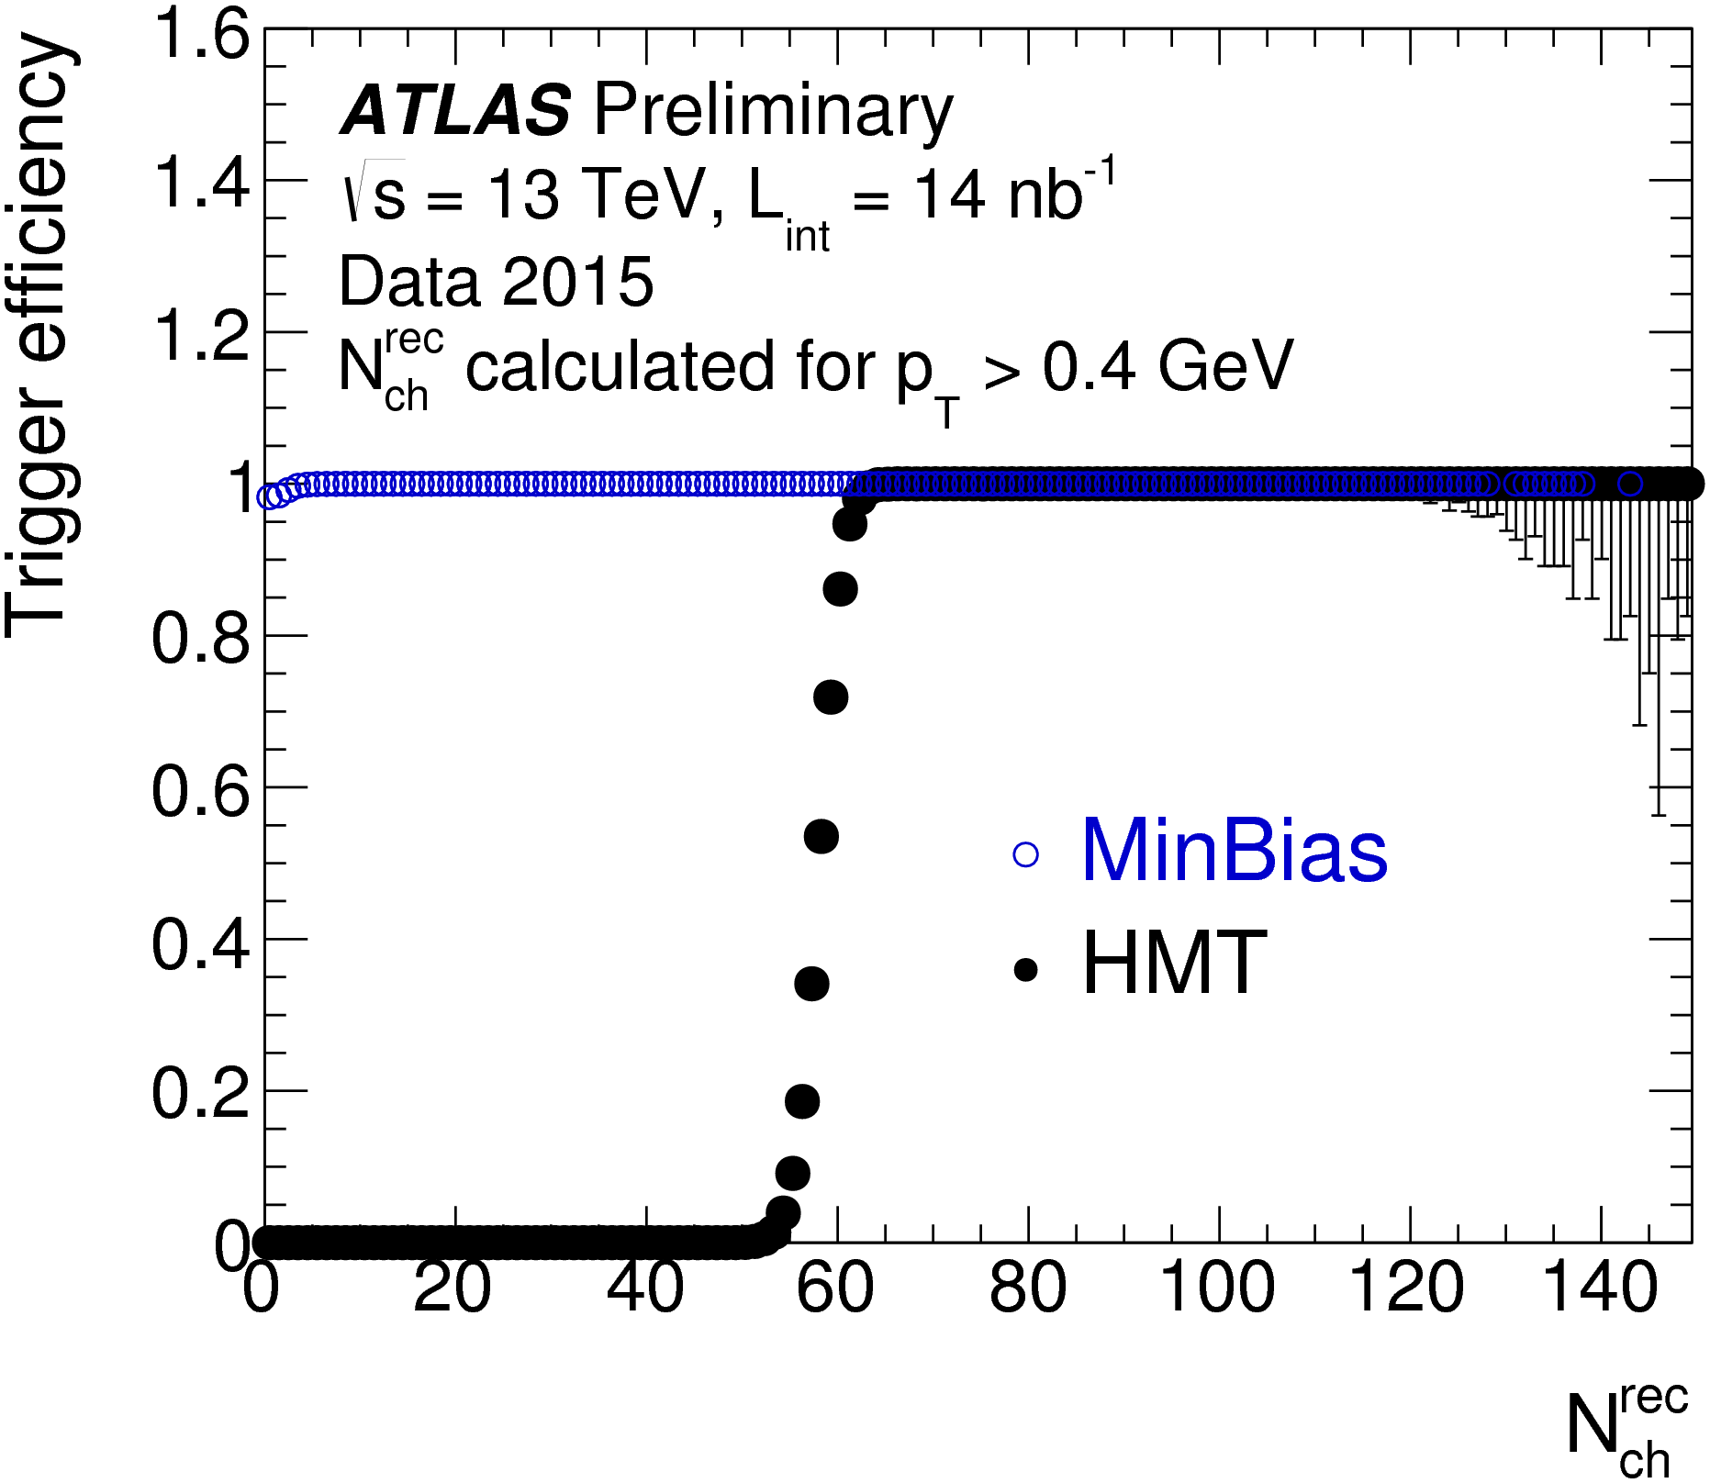
Performance
Statistics increased by x5.
Nominal bias introduced.
Multiple HMT triggers applied to $pp$ and $p$+Pb data taking

Slide 10
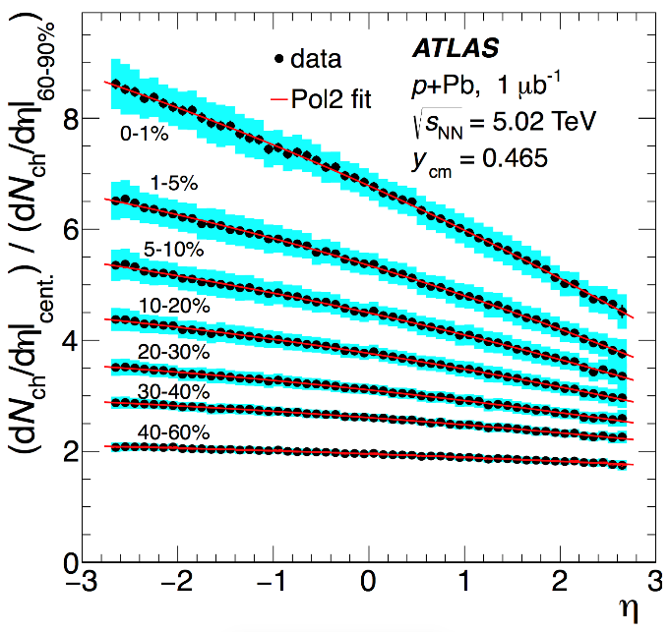
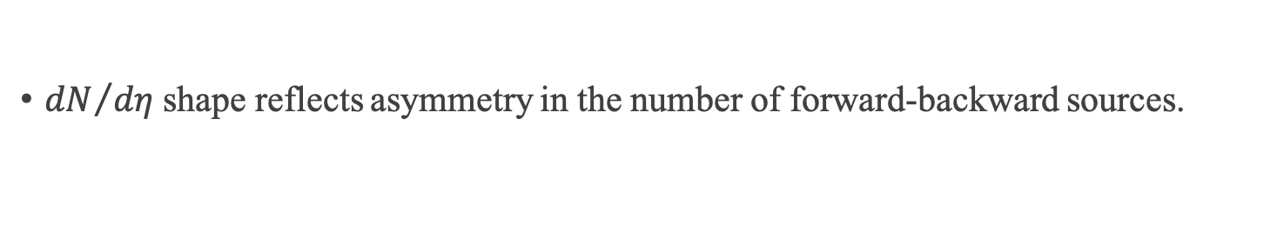
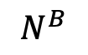
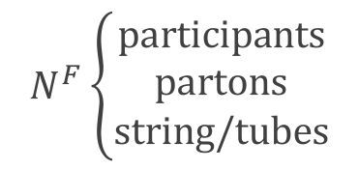
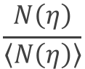
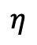
Long-range longitudinal correlation
Nature of sources seeding the long-range collective behaviors?
$$N^{F}\left\{\begin{aligned}participants \\ partons \\ string/tubes\end{aligned}\right.$$
$$N^{B}$$
${dN}/{dη}$ shape reflects asymmetry in the number of forward-backward sources.
Event-by-event multiplicity fluctuation?
Event 1
$$\frac{N\left(η\right)}{\left\langle N\left(η\right)\right\rangle }$$
Event 2
Natural asymmetry in p+Pb
$$η$$

Slide 11
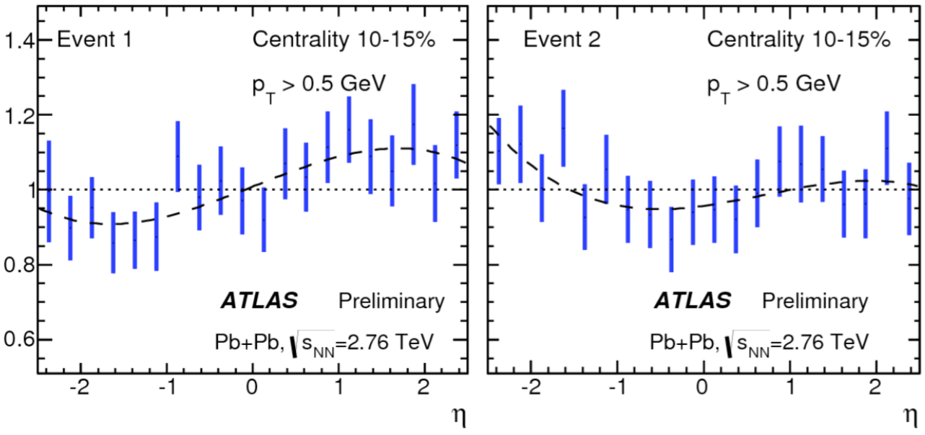
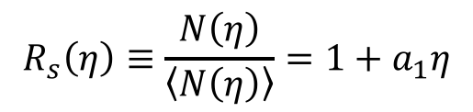
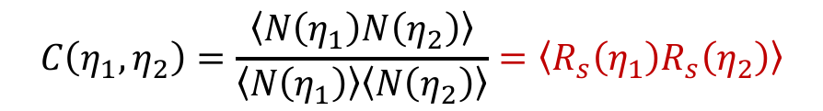
New observable
Single particle observable
$$R_{s}\left(η\right)≡\frac{N\left(η\right)}{\left\langle N\left(η\right)\right\rangle }=1+a_{1}η$$
Dominated by statistical fluctuations!
Two particles observable (correlation function)
$$C\left(η_{1},η_{2}\right)=\frac{\left\langle N\left(η_{1}\right)N\left(η_{2}\right)\right\rangle }{\left\langle N\left(η_{1}\right)\right\rangle \left\langle N\left(η_{2}\right)\right\rangle }=\left\langle R_{s}\left(η_{1}\right)R_{s}\left(η_{2}\right)\right\rangle$$
Two-particle correlation is related to single-particle distribution.
Advantage of correlation function
Disentangles dynamical fluctuation from statistical fluctuation.
Detector effects removed by mixed events;

Slide 12
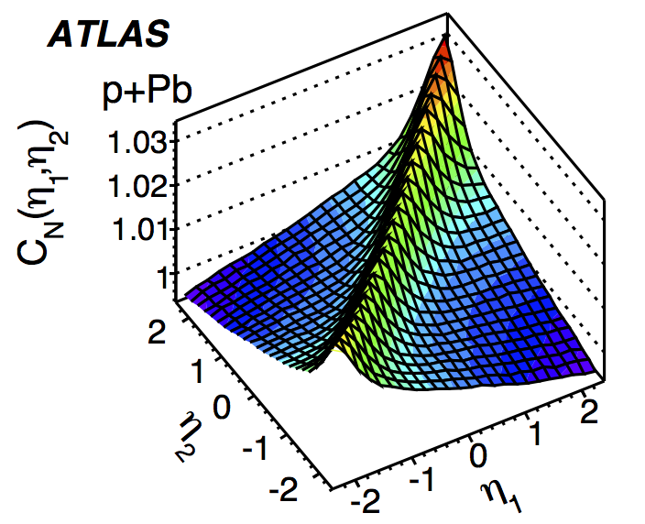
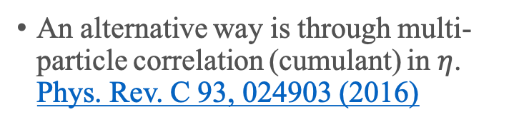
Physics signal and background
Short-range correlation reflects correlation in the same source: jet fragmentation, resonance decay…
Since SRC has a strong charge dependence, a data-driven way was developed to remove the SRC (backup).
An alternative way is through multi-particle correlation (cumulant) in $η$. Phys. Rev. C 93, 024903 (2016)
Long-range correlation
How to quantify forward-backward fluctuation?

Slide 13
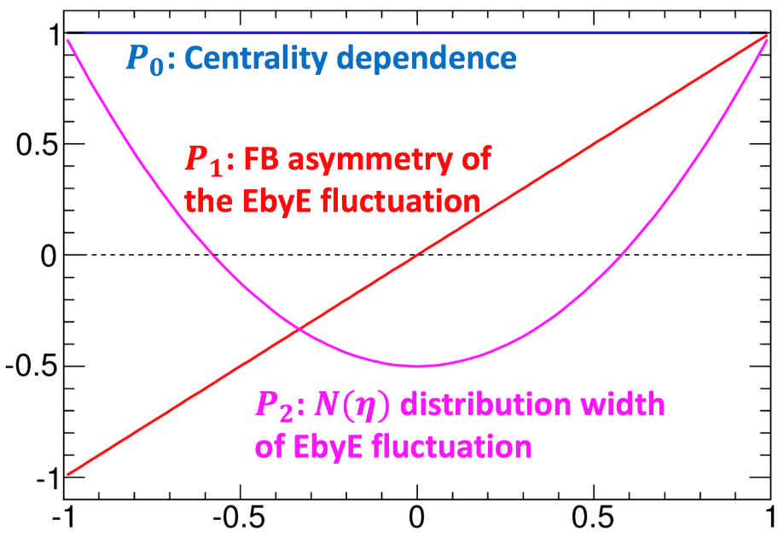
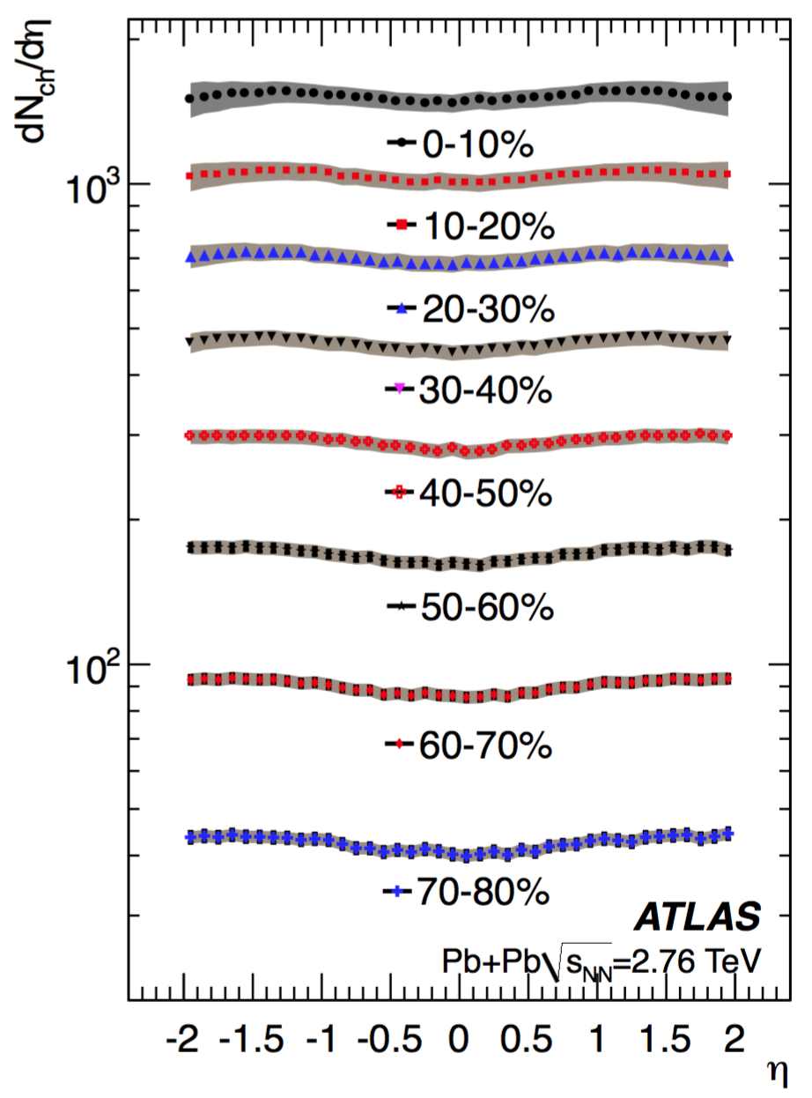
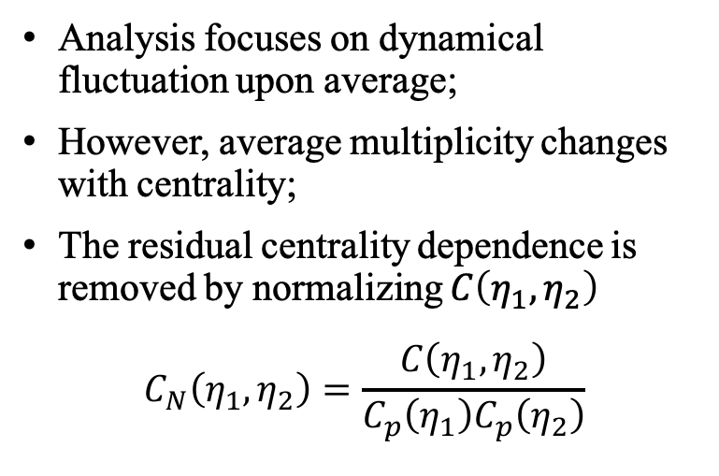
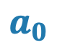
Legendre expansion: $a_{0}$
$$a_{0}$$
Analysis focuses on dynamical fluctuation upon average;
However, average multiplicity changes with centrality;
The residual centrality dependence is removed by normalizing $C\left(η_{1},η_{2}\right)$
$$C_{N}\left(η_{1},η_{2}\right)=\frac{C\left(η_{1},η_{2}\right)}{C_{p}\left(η_{1}\right)C_{p}\left(η_{2}\right)}$$

Slide 14
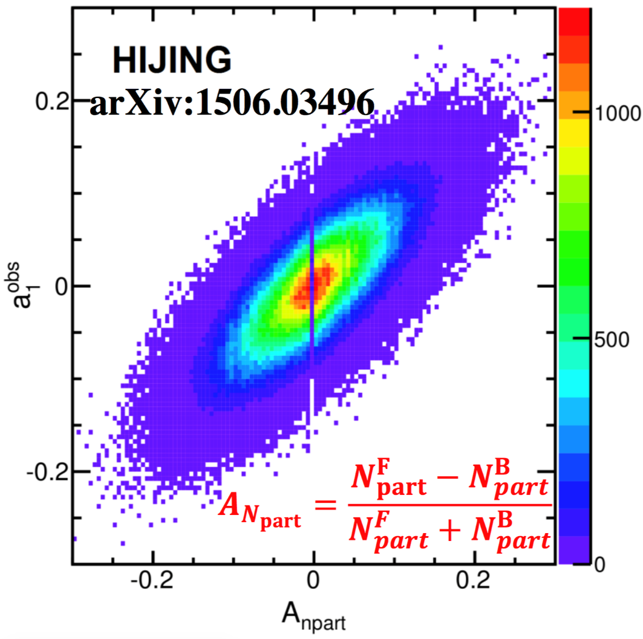
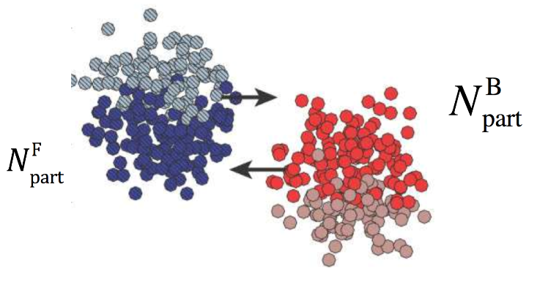
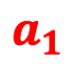
Legendre expansion: $a_{1}$
$$a_{1}$$
The linear shape quantifies the FB multiplicity asymmetry;
HIJING shows strong correlation between final multiplicity asymmetry and initial participant asymmetry;
As will be shown later, this component dominates the shape fluctuation.

Slide 15
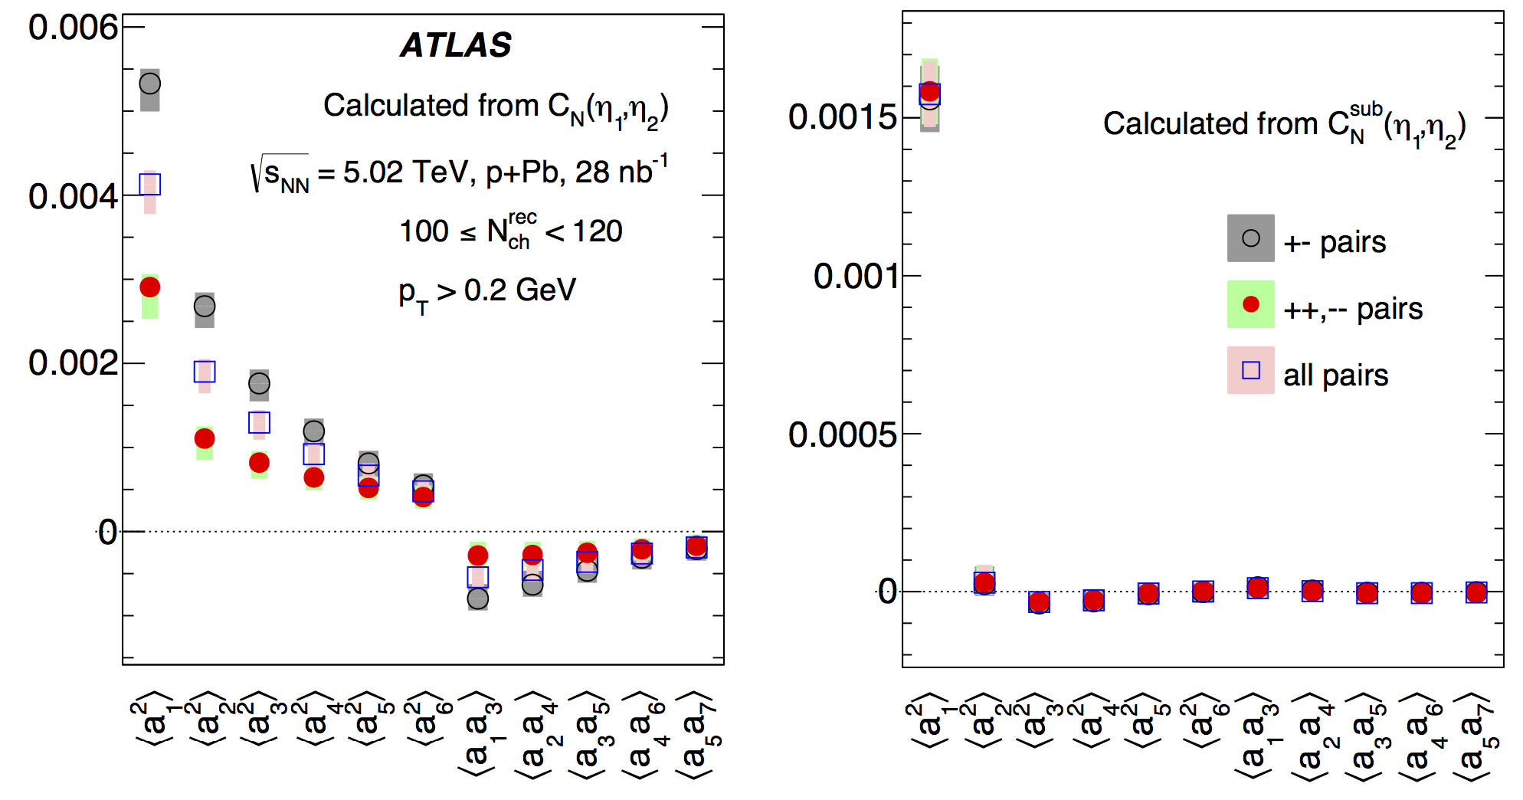
Why it is important to remove SRC?
Before SRC removal
After SRC removal
Oppo pairs
All
Same pairs
Higher order coefficients observed;
Coefficients have charge dependent;
Results hard to interpret: due to SRC!
Simpler picture after SRC removal!
LRC dominated by linear fluctuation;
LRC is charge independent.

Slide 16
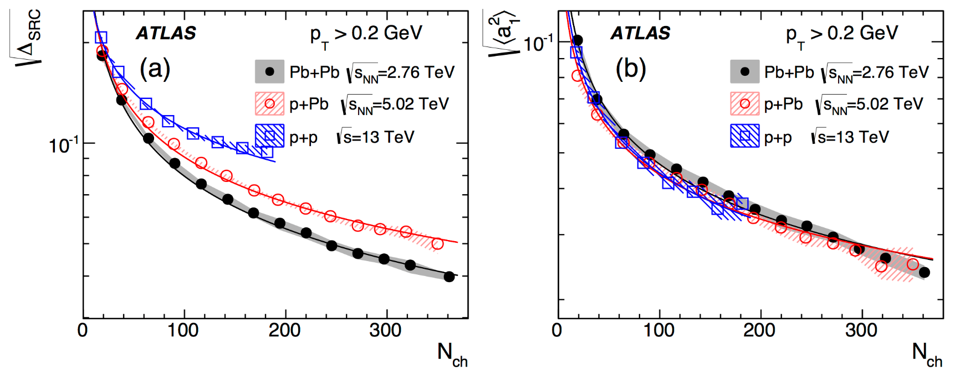
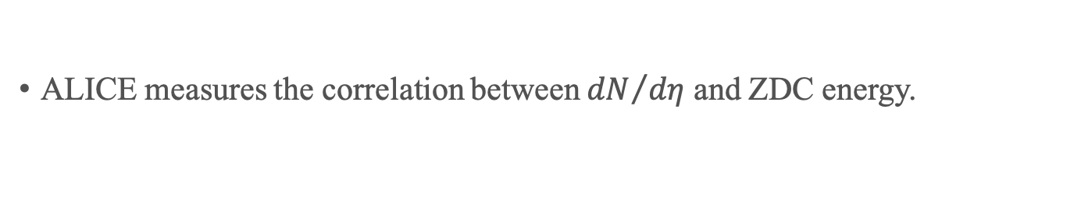
Results
SRC
LRC
SRC increases towards peripheral;
SRC is stronger in small systems;
FB fluctuation is larger in peripheral;
Independent of system size!
ALICE measures the correlation between ${dN}/{dη}$ and ZDC energy.
How will these new results help?

Slide 17
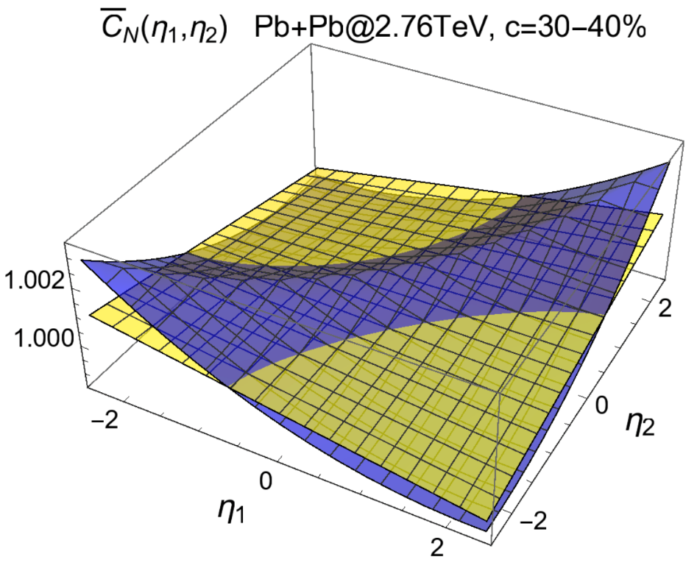
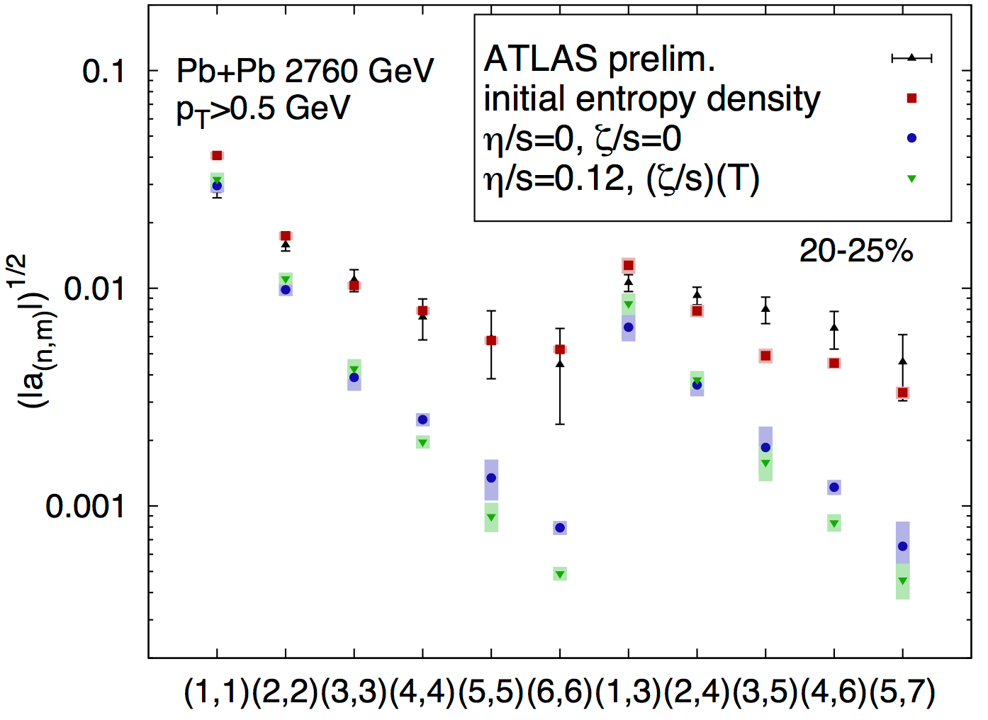
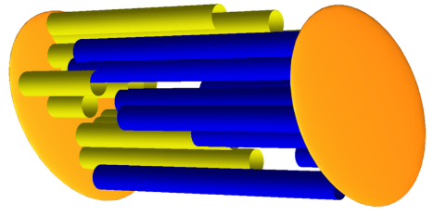
Model and data comparison
Phys. Lett. B 752 (2016) 317-321
Phys. Rev. C 93, 064910 (2016)
With length fluctuation
Hydro effect
Without length fluctuation

Slide 18
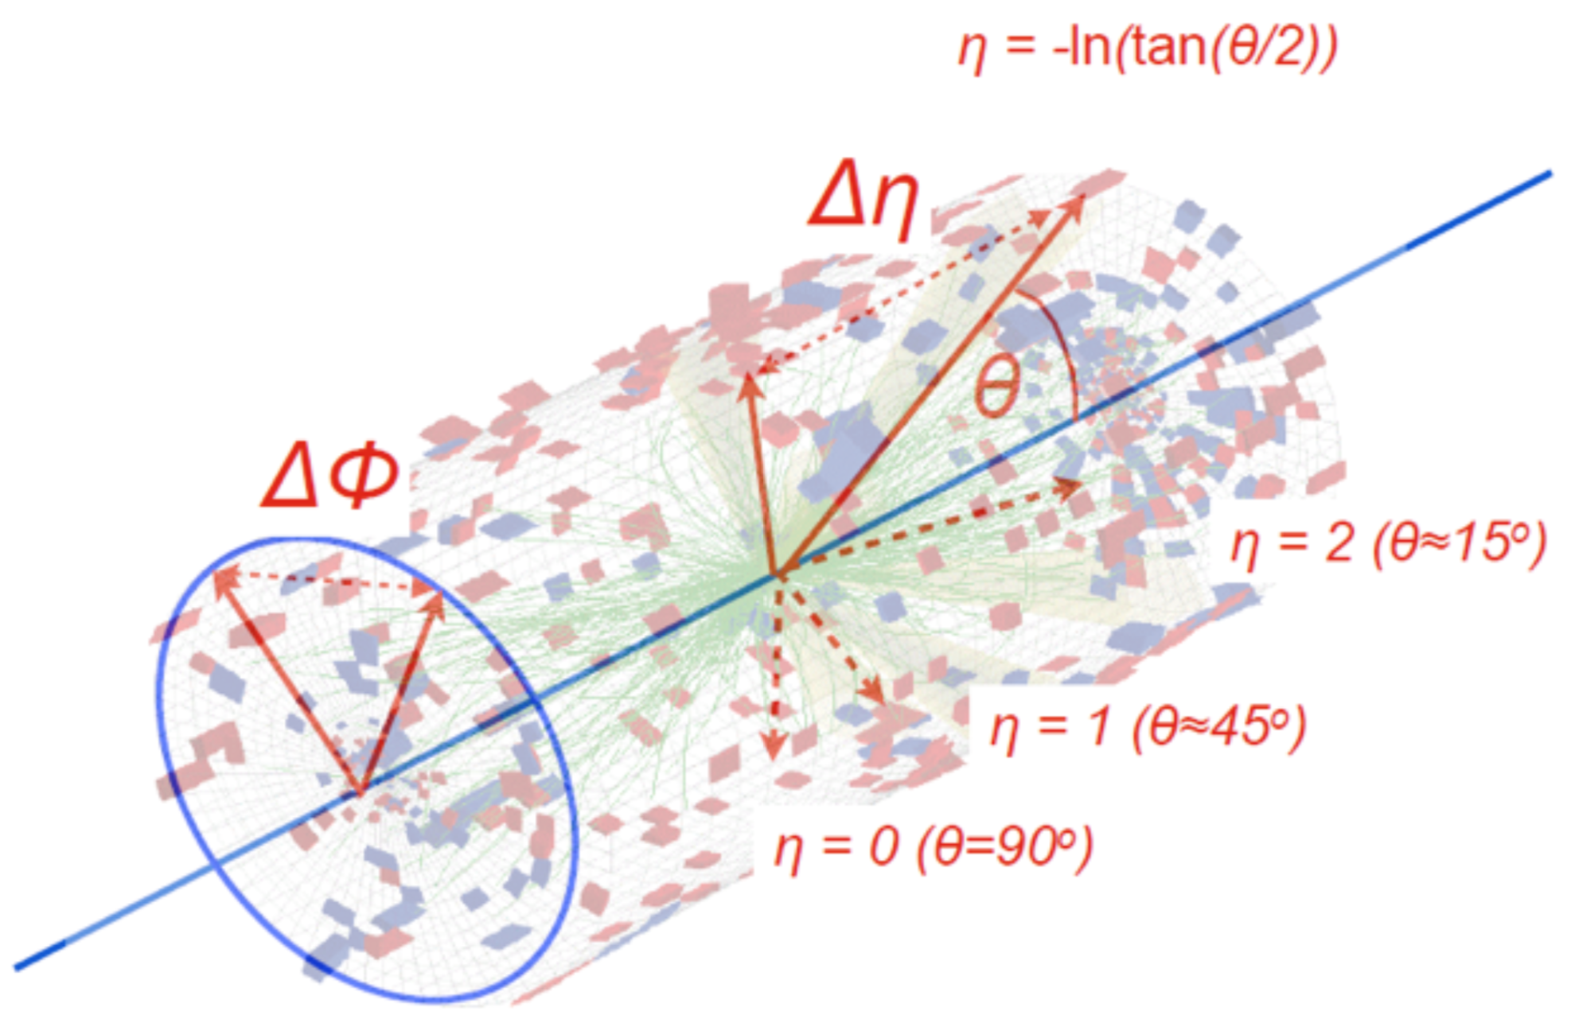
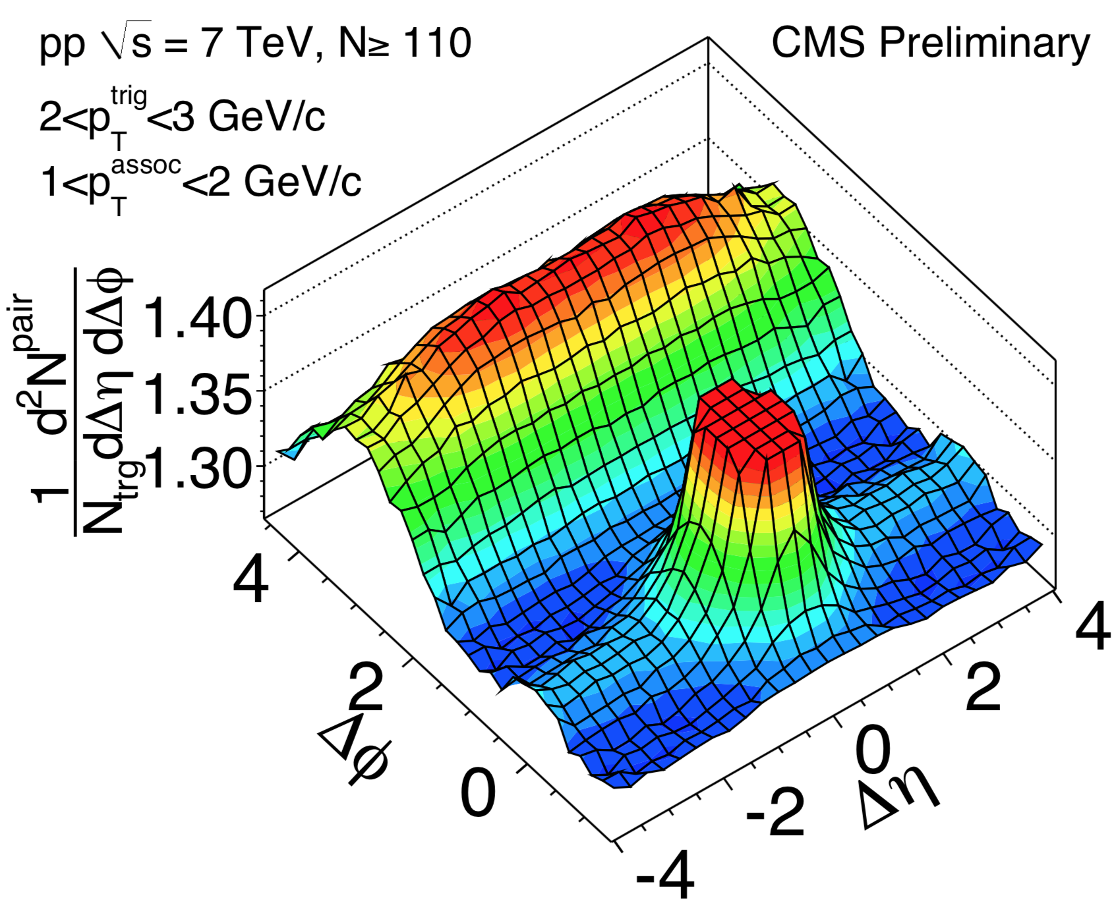
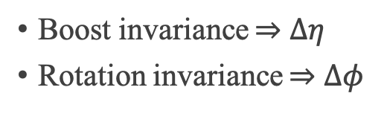
Long-range azimuthal correlation
Nature of sources seeding the long-range collective behaviors?
Azimuthal correlation in A+A: collective hydrodynamic expansion of nuclear matter;
J. Phys. G 38 (2011) 124051
Boost invariance $⇒$ $∆η$
Rotation invariance $⇒$ $∆φ$

Slide 19
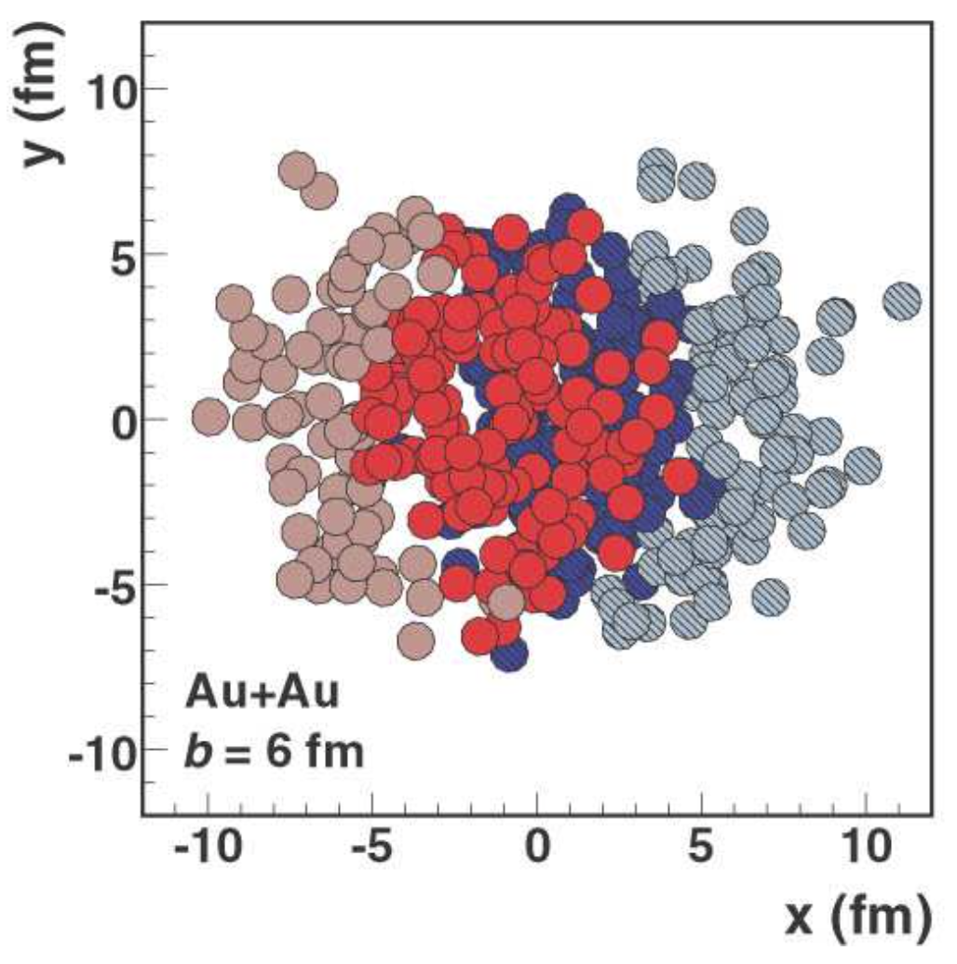
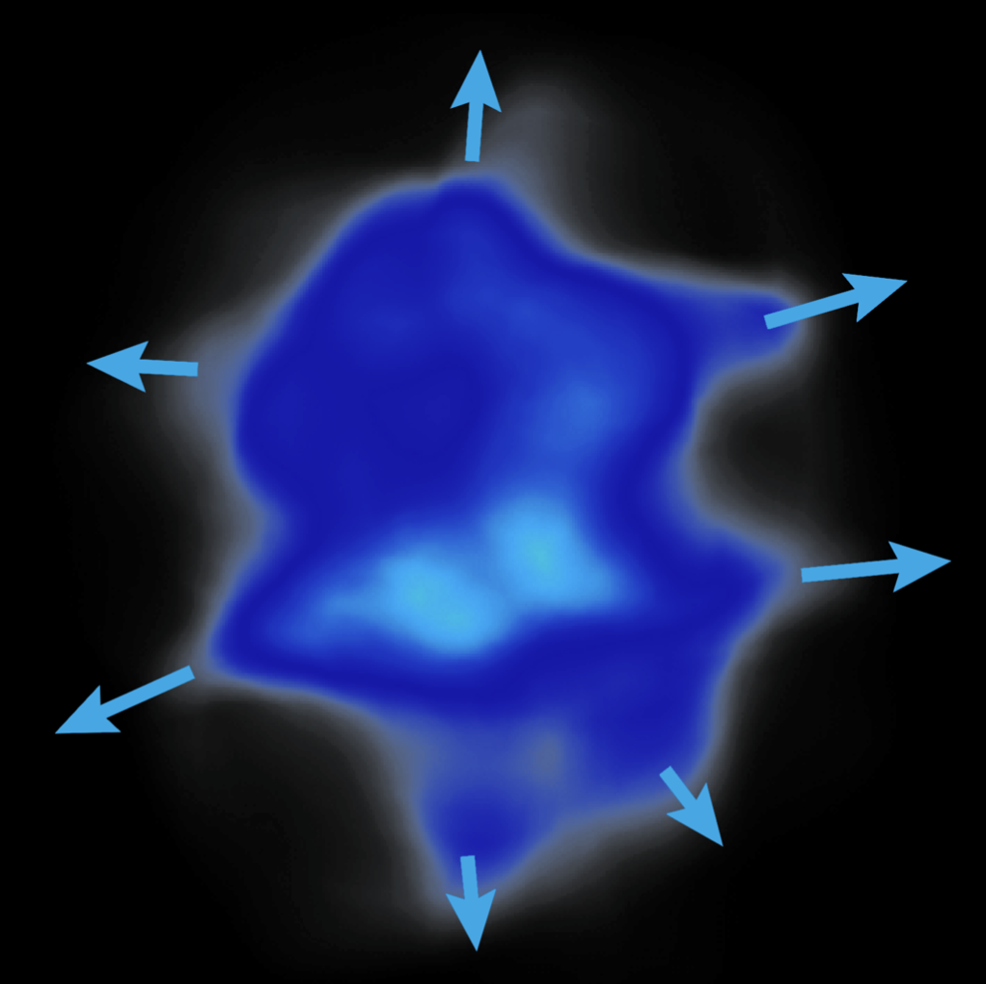
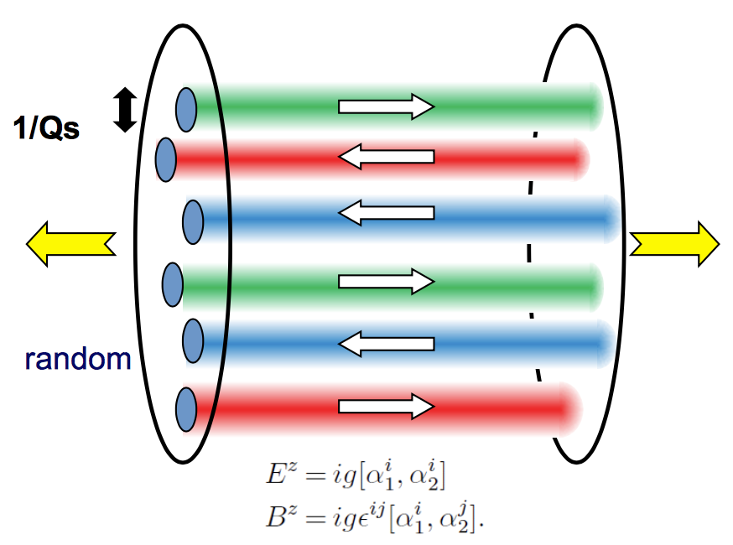
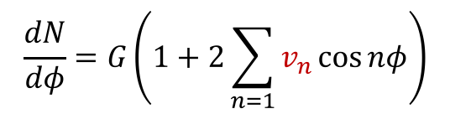

Origins of collectivity
$$\frac{dN}{dφ}=G\left(1+2\sum_{n=1}{v_{n}\cos{nφ}}\right)$$
Final state correlations
Hydrodynamic flow
Spatial structure from initial condition
Momentum correlations
More careful studies in $pp$ collisions are needed!
Initial state correlations
Particles are produced with momentum space correlations

Slide 20
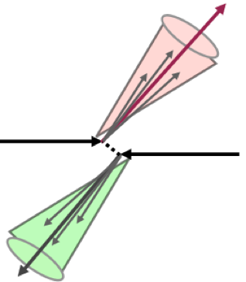
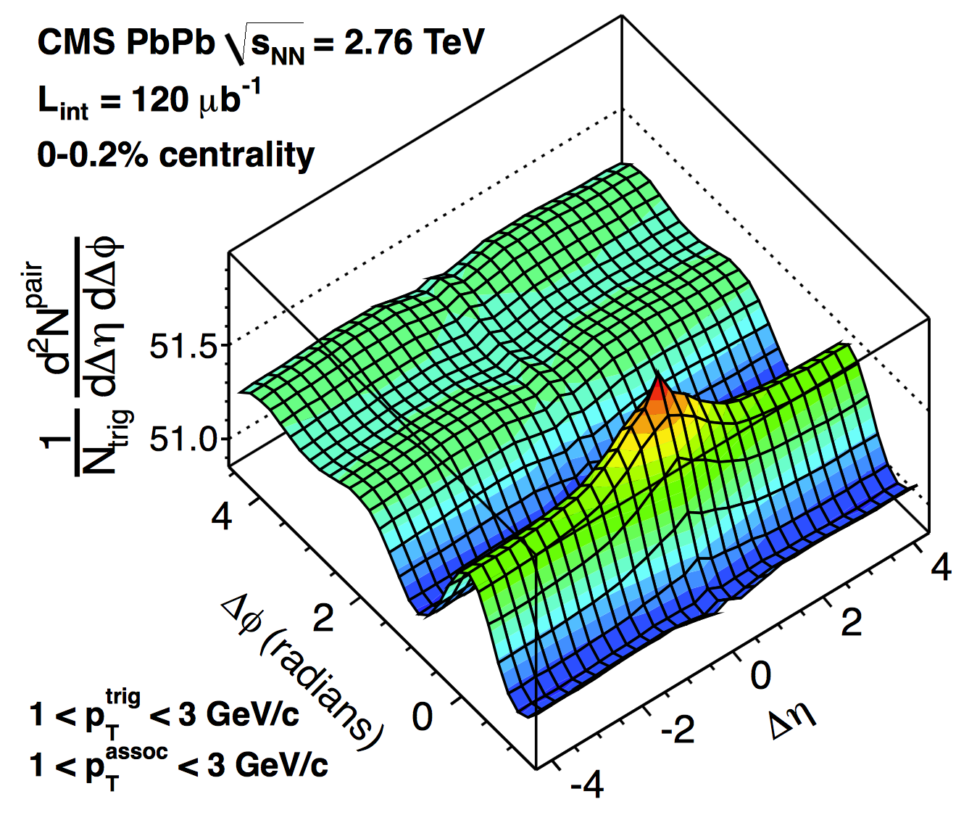
2-particle correlation
Back-to-back jet
Pb+Pb
pp
Short-range non-flow
Long-range collectivity
Dijet behaves like long-range collectivity;
Different methods used to remove dijet.

Slide 21
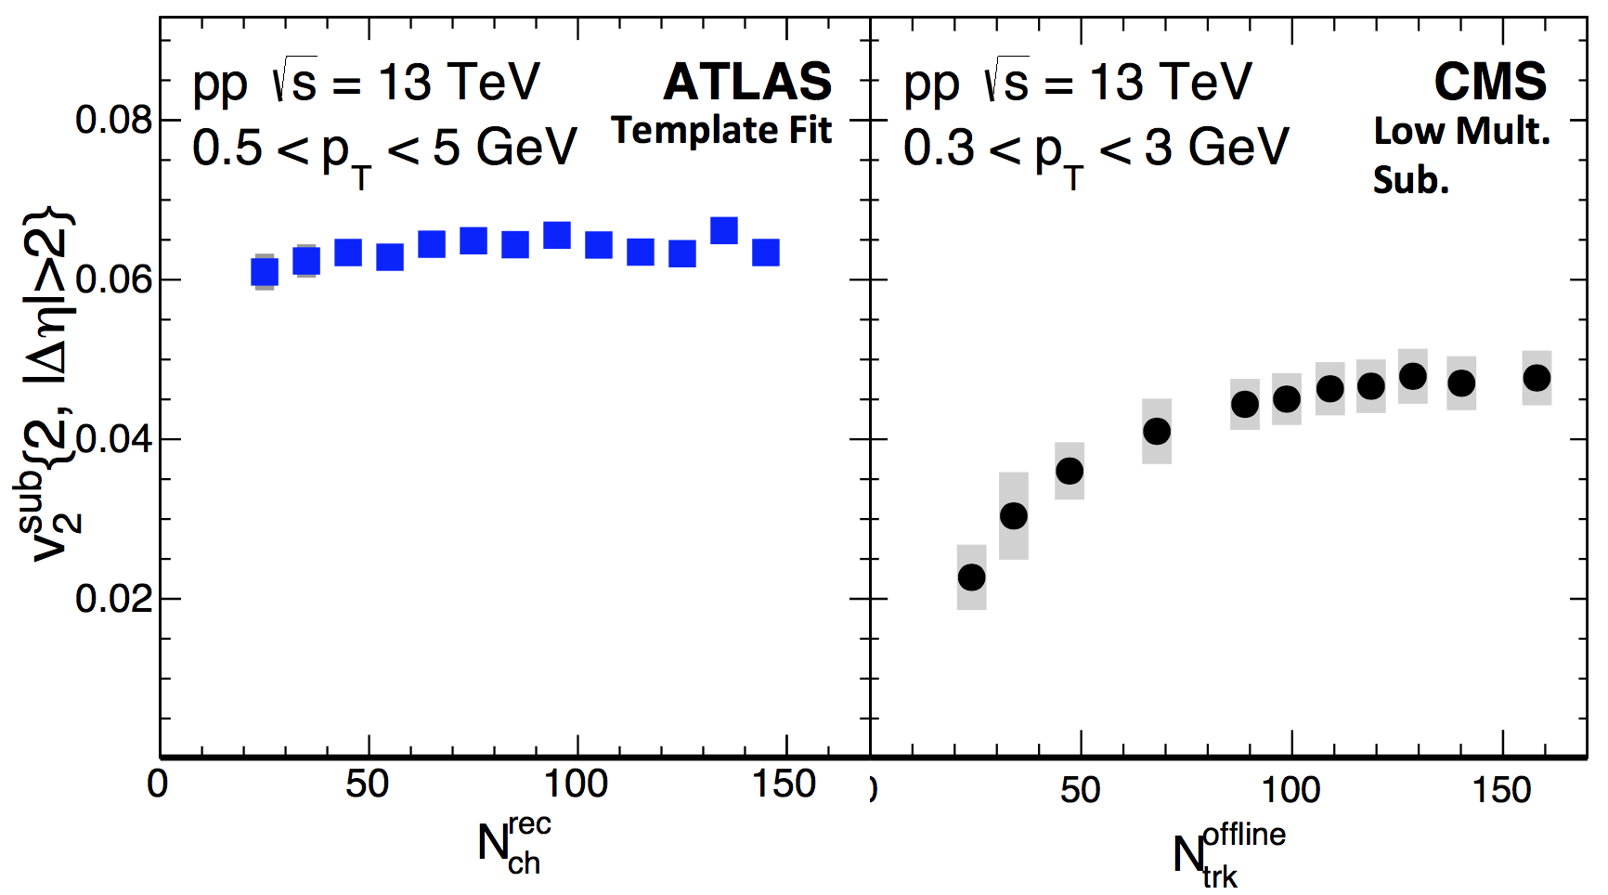
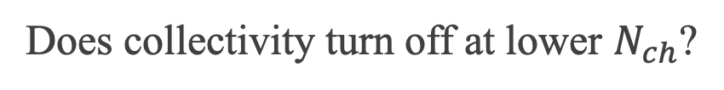
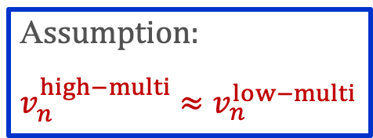
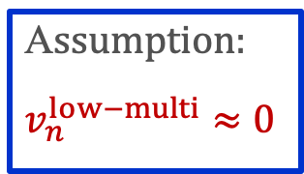
ATLAS v.s. CMS
A$ssumption$:
$$v_{n}^{high−multi}≈v_{n}^{low−multi}$$
A$ssumption$:
$$v_{n}^{low−multi}≈0$$
Does collectivity turn off at lower $N_{ch}$?

Slide 22


Hydro prediction
If hydro, $v_{2}$ should go down toward low $N_{ch}$;
Method free of assumptions?

Slide 23




Cumulant method
Multi-particle correlation ${corr}_{n}\left\{4\right\}≡\left\langle e^{in\left(φ_{1}+φ_{2}−φ_{3}−φ_{4}\right)}\right\rangle$
Genuine 4-particle correlation
2-particle non-flow
Multi-particle cumulant $c_{n}\left\{4\right\}≡\left\langle {corr}_{n}\left\{4\right\}\right\rangle −2{\left\langle {corr}_{n}\left\{2\right\}\right\rangle }^{2}$
Flow fluctuates from event to event;
Cumulant probes $p\left(v_{n}\right)$.
Features of cumulant method
Suppress non-flow (< 4 particles);
If $p\left(v_{n}\right)\sim Gauss$, then $c_{n}\left\{4\right\}=−{\overline{v}}_{n}^{4}$
$$δ_{n}$$
Cumulant proved successful in large systems, how about small systems?
$${\overline{v}}_{n}$$
JHEP11 (2013) 183

Slide 24

Results
Eur. Phys. J. C 77 (2017) 428
ATLAS
$$c_{n}\left\{4\right\}=−{\overline{v}}_{n}^{4}$$
CMS
To be collective, or not to be collective?

Slide 25


Other puzzles
Phys. Lett. B 765 (2017) 193
No hint of collectivity at lower energy?
$v_{2}\left\{2\right\}=v_{2}\left\{4\right\}+$ flow fluc
Flow fluc $≈$ 0 ?
Puzzles needs to be solved before testing models with data.

Slide 26

Signal or background?
Signal: collectivity
Background: dijets
Maybe background is the one to blame?

Slide 27




Test of background
non-flow
4% $v_{2}$
6% $v_{2}$
$$c_{n}\left\{4\right\}=−{\overline{v}}_{n}^{4}$$
Traditional cumulant cannot remove non-flow in $pp$

Slide 28





Traditional method
$$⇒ c_{2}\left\{4\right\}$$
Background
$$φ$$
$$η$$
High probability all four particles come from background;
Solution: higher-order cumulant (statistical significance), or…

Slide 29

Subevent method
$$⇒ c_{2}\left\{4\right\}$$
Background
$$φ$$
$$η$$
$$3>2$$

Slide 30

Validation in $pp$ PYTHIA
4% $v_{2}$
6% $v_{2}$
Subevent method can suppress non-flow in PYTHIA

Slide 31
Validation in $p$+Pb data
Large
non-flow
Small
non-flow

Slide 32


$c_{2}\left\{4\right\}$ in $pp$
Hydro?
4% $v_{2}$
4% $v_{2}\left\{4\right\}$ observed in $pp$!

Slide 33





Test of residual non-flow
$$c_{2}\left\{4\right\}≡{\left\langle nonflow+flow\right\rangle }_{evt}$$
Non-flow changes greatly EbyE
Flow changes little EbyE
non-flow fluc. $←$ multiplicity fluc. $←$ how ${\left\langle …\right\rangle }_{evt}$ is defined: $N_{ch}^{Sel}$
$N_{ch}^{Sel}$ defined with different $p_{T}$: very different non-flow fluctuation.
$N_{ch}^{Sel}$ defined with $0.3<p_{T}<3.0$ GeV
$N_{ch}^{Sel}$ defined with $p_{T}>0.4$ GeV
Non-flow fluctuation might mimic the flow signal (negative $c_{2}\left\{4\right\}$)!

Slide 34




Puzzle 1: $N_{ch}^{sel}$ dependence
Different f$or N_{ch}^{sel}$
Different $N_{ch}^{Sel}$
Different non-flow fluctuation
Different $c_{2}\left\{4\right\}$
?
?
non-flow fluctuation
4% $v_{2}$
?
Less non-flow
Weaker non-flow fluctuation
Weaker $N_{ch}^{Sel}$ dependence
Data-driven method to test residual non-flow

Slide 35

Puzzle 2: energy dependence
Weak energy dependence in $pp$;
$p$+Pb has larger flow than $pp$;

Slide 36




Puzzle 3: flow fluctuation
$v_{2}\left\{2\right\}$ from template fit
$v_{2}\left\{4\right\}$ from 3 subevent
$v_{2}\left\{2\right\}$ from peripheral sub.
$v_{2}\left\{4\right\}<v_{2}\left\{2\right\}$ (template fit): flow fluctuation;
$v_{2}\left\{4\right\}≈v_{2}\left\{2\right\}$ (peripheral sub.): underestimation of $v_{2}\left\{2\right\}$;
Subevent cumulant is more robust.

Slide 37





Number of sources
$v_{2}\left\{2\right\}≠v_{2}\left\{4\right\}$: EbyE flow fluctuations associated with fluctuating initial conditions. Phys. Rev. Lett. 112, 082301 (2014)
Fluctuation can be quantified to the number of sources $N_{s}$ in the initial stage:
$$\frac{v_{2}\left\{4\right\}}{v_{2}\left\{2\right\}}={\left(\frac{4}{3+N_{s}}\right)}^{1/4}$$
$$\frac{N\left(η\right)}{\left\langle N\left(η\right)\right\rangle }≈1+a_{1}η, a_{1}∝1/{\sqrt{N_{s}}}$$
$N_{s}$?
$N_{s}$ for $p$+Pb goes up to 20 at high multiplicity;
$N_{s}$ for $pp$ approximately consistent with $p$+Pb at comparable $\left\langle N_{ch}\right\rangle$ value.

Slide 38



Nucleon substructure fluctuation
Pb
p

Slide 39


Non-non-flow $≠$ Flow!

Slide 40



Third harmonic $v_{3}$
$c_{3}\left\{4\right\}$ is consistent with 0
${\overline{v}}_{3}≪{\overline{v}}_{2}$?
Fluctuation kills $v_{3}\left\{4\right\}$?
More statistics needed.

Slide 41
$v_{3}$ projected in Run 3
Opportunity luminosity increase in Run 3;
Challenges trigger, pileup, tracking...

Slide 42

Correlation between $v_{n}$ and $v_{m}$
$${nsc}_{n,m}\left\{4\right\}=\frac{\left\langle v_{n}^{2}v_{m}^{2}\right\rangle −\left\langle v_{n}^{2}\right\rangle \left\langle v_{m}^{2}\right\rangle }{\left\langle v_{n}^{2}\right\rangle \left\langle v_{m}^{2}\right\rangle }$$
Phys. Lett. B 789 (2019) 444
Same sign, different magnitudes across systems;
Additional constrains on models.

Slide 43


Last puzzle: $N_{ch}$ dependence
Weak independence of $N_{ch}$;
Similar observation in model
No “geometry” in $pp$?
$N_{ch}$ not a good indicator for centrality?
Phys. Rev. C 94, 024919 (2016)

Slide 44

Centrality fluctuation
Centrality quantifies the overlap region of the collision;
The mapping replies on model and is on the average level;
Different centrality definitions gives different dependence.

Slide 45

Summary
Nature of sources seeding the long-range collective behavior?
Longitudinal
correlation
Azimuthal
correlation
Evidence of collectivity in small systems!

Slide 46





Summary
Standard cumulant
Subevent cumulant
Hypothesis
Collectivity in $pp$?
Negative $c_{2}\left\{4\right\}$
Hints of ridge
Data Gather
Real-time selection
Data Analysis
Large background
New Algorithm
$$3>2$$
HMT trigger
Conclusion
Collectivity in $pp$!
Outlook
Other observables
Puzzles
$v_{3}\left\{4\right\}$?
ATLAS
CMS

Slide 47
Final note
O+O to O+O

Slide 48
Backup
Forward-backward multiplicity correlation;
Flow and centrality fluctuation;
Novel collision system Xe+Xe.

Slide 49
Forward-backward multiplicity fluctuation

Slide 50

Motivation: a historical view
Rapidity correlations is an old story
ISR
UA5
UA5
E735
PHOBOS
STAR
ATLAS
ALICE
1976
1983
1988
1995
2006
2009
2012
2015
Year
Physics goal: understand production mechanism in early stage.
More details see the thesis.
Why we come back to this analysis?
Previous methods focused on limited phase space: $η$ and $−η$;
We used a new observable that covers full $η$ space;
Short-range correlation and statistical dilution;
We estimated short-range correlation;
Few direct comparisons among different systems;
We compared from large to small systems.

Slide 51




Pb+Pb, $p$+Pb and $pp$ datasets
Correlation functions calculated using charged particles $p_{T}>0.2$ GeV;
High-multiplicity track (HMT) trigger used to increase statistics;
Analysis carried out in many bins over $10≤N_{ch}^{rec}<300$;
Results presented as a function efficiency-corrected values $N_{ch}$.
How long-range correlation compare among three systems, at the same $N_{ch}$?

Slide 52




Charge dependence of $C\left(η_{1},η_{2}\right)$
Particles from the same source (SRC) have strong charge dependence.
$$η_{+}≡η_{1}+η_{2}$$
Opposite
charges
Same
charges
$$\frac{oppo}{same}$$
Ratio of opposite to same charges $R\left(η_{1},η_{2}\right)$
Very strong Gaussian-like SRC;
Very weak LRC: charge-independent;
Amplitude of $R\left(η_{1},η_{2}\right)$ along $η_{+}$: $f\left(η_{+}\right)$, reflects the strength of SRC in the longitudinal direction;
Assumption: strength of SRC along $η_{+}$ is same for same charge and opposite charge.

Slide 53




Estimation of short-range correlation
To estimate SRC, LRC pedestal is estimated first.
SRC
Same
charges
$C\left(η_{1},η_{2}\right)$ from same charge used to estimate LRC pedestal because of small SRC;
LRC pedestal is fitted with quadratic function;
The additional structure upon LRC pedestal determines the shape of SRC;
The full $δ_{SRC}\left(η_{1},η_{2}\right)$ is then populated using $f\left(η_{+}\right)$ scaling.

Slide 54





Legendre expansion: from $a_{n}$ to $\left\langle a_{n}a_{m}\right\rangle$
Expansion of correlation function $C_{N}\left(η_{1},η_{2}\right)$
$$1+\sum_{n.m=1}^{∞}{\left\langle a_{n}a_{m}\right\rangle \frac{T_{n}\left(η_{1}\right)T_{m}\left(η_{2}\right)+T_{n}\left(η_{2}\right)T_{m}\left(η_{1}\right)}{2}}$$
$$η_{+}$$
If linear shape dominates:
$$C_{N}\left(η_{1},η_{2}\right)=1+\left\langle a_{1}^{2}\right\rangle η_{1}η_{2}$$
Expressed as $η_{+}$ and $η_{−}$:
$$C_{N}\left(η_{1},η_{2}\right)=1+\frac{\left\langle a_{1}^{2}\right\rangle }{4}\left(η_{+}^{2}−η_{−}^{2}\right)$$
$$η_{−}$$

Slide 55




Results: correlation function
Raw
$$C_{N}\left(η_{1},η_{2}\right)$$
=
Short-range
$$δ_{SRC}\left(η_{1},η_{2}\right)$$
+
Long-range
$$C_{N}^{sub}\left(η_{1},η_{2}\right)$$
Pb+Pb
p+Pb
pp

Slide 56




Other methods to measure $\left\langle a_{1}^{2}\right\rangle$
$$C_{N}\left(η_{1},η_{2}\right)$$
Expansion of $C_{N}^{sub}\left(η_{1},η_{2}\right)$
$$C_{N}^{sub}\left(η_{1},η_{2}\right)=1+\left\langle a_{1}^{2}\right\rangle η_{1}η_{2}$$
Quadratic fit along $C_{N}^{sub}\left(η_{−}\right)$
$$C_{N}^{sub}\left(η_{−} \right)=1+\frac{\left\langle a_{1}^{2}\right\rangle }{4}\left(η_{+}^{2}−η_{−}^{2}\right)$$
Quadratic fit along $C_{N}^{sub}\left(η_{+}\right)$
$$C_{N}^{sub}\left(η_{−} \right)=1+\frac{\left\langle a_{1}^{2}\right\rangle }{4}\left(η_{+}^{2}−η_{−}^{2}\right)$$
Linear fit of $r_{N}^{sub}\left(η,η_{ref}\right)≡\frac{C_{N}^{sub}\left(−η,η_{ref}\right)}{C_{N}^{sub}\left(η,η_{ref}\right)}$
$$r_{N}^{sub}\left(η,η_{ref}\right)=1−2\left\langle a_{1}^{2}\right\rangle ηη_{ref}$$
LRC
SRC
$$η_{1}$$
LRC
$$η_{2}$$
Four methods have different responses of the analysis procedures, and are largely independent.

Slide 57


How stable are the results?
Four largely independent methods are applied to determine $\left\langle a_{1}^{2}\right\rangle$;
Different methods have different sensitivity to the analysis procedures;
Four methods give consistent $a_{1}$: conclusions are insensitive to the procedure.

Slide 58






Asymmetry in $p$+Pb collision
$$p$$
$$SRC$$
Asymmetry entirely due to SRC!
$$p$$
$$p$$
$$LRC$$
Asymmetry observed in p+Pb collision: stronger correlation in the proton-going side.
LRC is symmetric.
Why the asymmetric collision causes asymmetric SRC?

Slide 59




SRC asymmetry in $p$+Pb collision
$$p$$
$$p$$
Assume there are $n$ clusters and each one emits $m$ particles on average;
Assume $n$ is proportional to local particle density ${dN_{ch}}/{dη}$;
$$δ_{SRC}∝\frac{n\left\langle m\left(m−1\right)\right\rangle }{{\left(n\left\langle m\right\rangle \right)}^{2}}=\frac{1}{n}∝\frac{1}{{dN_{ch}}/{dη}}$$
Inverse to multiplicity distribution

Slide 60

Compare SRC shape in three systems
Symmetrized p+Pb
pp
Pb+Pb
For better comparison with pp and Pb+Pb, p+Pb is symmetrized;
In high-multiplicity pp, SRC shape is slightly larger than p+Pb;
However in Pb+Pb, SRC shape is more flat.
EbyE asymmetry of multiplicity (relative to average multiplicity) in high-multiplicity pp is larger than p+Pb while Pb+Pb collision is more symmetric.

Slide 61







Outlook
$C\left(η_{1},η_{2}\right)$ is a very comprehensive observable.
Reconstruct balance function
$$2B\left(Δη\right)≡2C^{+−}\left(Δη\right)−C^{++}\left(Δη\right)−C^{−−}\left(Δη\right)$$
Test factorization: high-$p_{T}$ $a_{n}^{H}$ and low-$p_{T}$ $a_{n}^{L}$
$$r_{n}≡\frac{\left\langle a_{n}^{H}a_{n}^{L}\right\rangle }{\sqrt{\left\langle a_{n}^{H}a_{n}^{H}\right\rangle }\sqrt{\left\langle a_{n}^{L}a_{n}^{L}\right\rangle }}$$
$$C\left(η_{1},η_{2}\right)$$
+
$C\left(η_{1},η_{2},Δφ\right)$ !
$$C\left(Δη,Δφ \right)$$

Slide 62
Centrality fluctuation

Slide 63



Ultra-Central Collision (UCC)
Cent.
2%
1%
0.1%
In UCC: ${\overline{v}}_{2}→0$, largest relative flow fluctuation;
ATLAS applied UCC triggers: $×$20 statistics over MinBias;
$c_{2}\left\{4\right\}>0$ in UCC $⇒$ non-Gaussian flow fluctuation
Why?

Slide 64






Initial stage and hydro response
PLB 659 (2008) 537-541
PRC 87 (2013) 054901
Hydro
Gaussian $p\left(ε_{2}\right)$
$$v_{2}\sim ε_{2}$$
Glauber 20-30%
$$v_{n}\left\{4\right\}={\overline{v}}_{n}=\sqrt[4]{−c_{n}\left\{4\right\}}$$
On the model side
Gaussian $p\left(ε_{2}\right)⇒$ Gaussian $p\left(v_{2}\right)⇒$ $c_{2}\left\{4\right\}≤0$
But we observed $c_{2}\left\{4\right\}>0$
Non-flow contribution?

Slide 65

Non-flow contribution?
Cent.
2%
1%
0.1%
Two methods consistent: not due to non-flow.
Pileup effects have also been suppressed.

Slide 66




Centrality (volume) Fluctuation (CF)
Initial stage sources $N_{part}$
Final stage particles $N_{ch}$
Not detector effect!
Fluctuation of particle production $p\left(n\right)$
Same $N_{part}⇒$ different $N_{ch}$
Same $N_{ch}⇒$ different $N_{part}$
In the experiment
First calculate $𝒪bs\left(N_{ch}\right)$
Then map to $\left\langle N_{part}\right\rangle$
Flow is driven by initial stage $N_{part}$
$𝒪bs\left(\left\langle N_{part}\right\rangle \right)$ introduces CF
CF affects all fluctuation measurements, but never been studied in flow
$$p\left(n\right)$$

Slide 67








How to test centrality fluctuation in data?
$$c_{n}\left\{4\right\}≡\left\langle \left\langle 4\right\rangle \right\rangle −2{\left\langle \left\langle 2\right\rangle \right\rangle }^{2}$$
Binning defined by | Observable
FCal: $3.2<\left|η\right|<4.9$ | $$c_{2}\left\{4,ΣE_{T}\right\}$$
ID: $\left|η\right|<2.5, p_{T}$ cut | $$c_{2}\left\{4,N_{ch}^{rec}\right\}$$
Calculated event-by-event
Averaged over many events
Particle production depends on $η$
Test relative CF by comparing $c_{2}\left\{4\right\}$ binned by $ΣE_{T}$ and $N_{ch}^{rec}$
$$N_{part}$$
$p\left(N_{ch}^{rec}\right)$broader than $p\left(ΣE_{T}\right)$
CF effect: $ΣE_{T}<N_{ch}^{rec}$
Prediction
$c_{2}\left\{4,ΣE_{T} \right\}<c_{2}\left\{4,N_{ch}^{rec}\right\}$
$$ΣE_{T}$$
$${ N}_{ch}^{rec}$$
arXiv:1803.01812

Slide 68


$c_{2}\left\{4\right\}$ and centrality fluctuation
Cent.
2%
1%
0.1%
$c_{2}\left\{4,{ΣE}_{T} \right\}<c_{2}\left\{4,N_{ch}^{rec}\right\}$: CF affects flow cumulant;
$c_{2}\left\{4\right\}→0$ in very most-central: smaller CF effect;

Slide 69



From ultra-central to full centrality
$$c_{2}\left\{4\right\}$$
$$c_{3}\left\{4\right\}$$
$c_{2}\left\{4\right\}$: CF mostly affects central;
$c_{3}\left\{4\right\}$: CF affects most centralities.

Slide 70
Comparison between Pb+Pb and Xe+Xe

Slide 71

Xe+Xe and Pb+Pb: $v_{2}$
Mass number of Xe is halfway of Pb and $p$;
If $v_{2}\sim Gauss\left({\overline{v}}_{n},δ_{n}\right)$: ${v_{2}\left\{6\right\}}/{v_{2}\left\{4\right\}}=1$
$v_{2}$ in Xe+Xe deviates further from Gauss: deformed nucleus?

Slide 72

Xe+Xe and Pb+Pb: $v_{3}$
$c_{3}\left\{4\right\}$ doesn’t scale with centrality between Xe and Pb
No avg. geometry for $v_{3}$;
$c_{3}\left\{4\right\} s$cales with $\left\langle N_{part}\right\rangle$
Fluctuation driven by # of sources $N_{part}$
Similar observation for $c_{4}\left\{4\right\}$ (see backup)

Slide 73
Multi-particle cumulant

Slide 74
Differential cumulant

Slide 75
Symmetric cumulant

Slide 76
$$c_{2}\left\{4\right\}$$

Slide 77
$$c_{3}\left\{4\right\}$$

Slide 78
Title

